Slide 1



Spotify Trends Analysis
Marianne STEPHANIDES
Merve TASKAYA
Bernhard WEGHAUPT
Tomasz WLODARSKI

Slide 2
Introduction

Slide 3

Research questions
About us
How can we effectively group and categorize music genres from the Spotify dataset into a smaller number of genre clusters, and what insights can we gain from these genre groupings in terms of popularity, artist diversity, and track characteristics?
Can trends or sentiments in song lyrics using NLP techniques be identified, and how do these trends correlate with song popularity?
Our Dataset
research questions
Insights into dataset

Slide 4
Related Work/Motivation

Slide 5

Methods: Our Data
About us
three CSV files:
spotify_albums
75511 rows
spotify_artists
56129 rows
spotify_tracks 101939 rows
Our dataset
spotify_tracks
spotify_artists
spotify_albums
research questions
Insights into dataset

Slide 6
Methods: Our Data
About us
main dataset → spotify_tracks
Audio features available:
Accousticness, dancebility
Genres (missing for 42% of dataset)
Lyrics (available in different languagse)
spotify_artists
Popularity
followers
Our Dataset
research questions
Insight into dataset

Slide 7
Preprocessing Steps - Genres
Preprocessing Steps
Genres:
convertion into list
lowercase
remove characters
Tokenization
No „classic“ stopwords
EDA

Slide 8
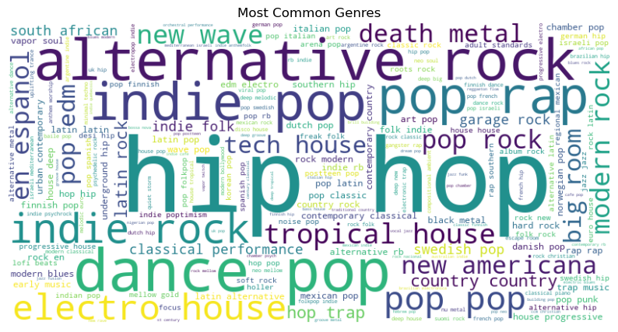
Word Cloud Genres

Slide 9
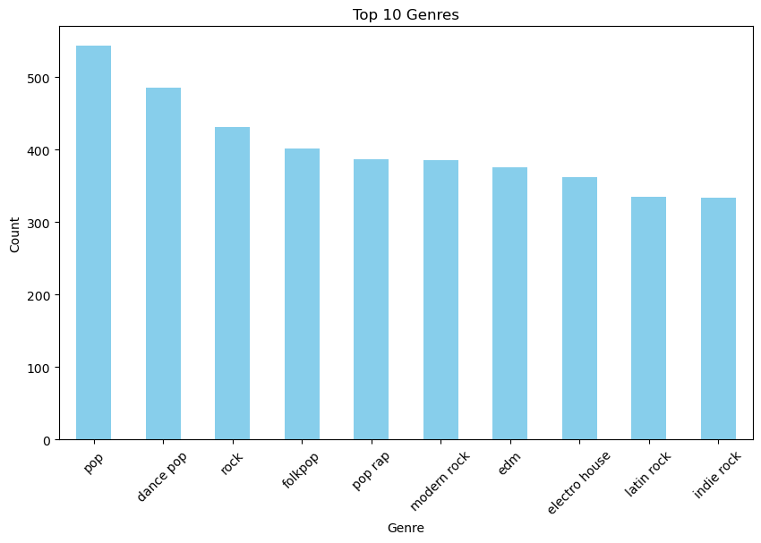
Top Genres

Slide 10
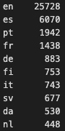
Preprocessing Steps - Lyrics
Preprocessing Steps
Lyrics:
Replace ‚\r\n‘ with space
Detect language
Translate lyrics into english (failed so far – filter english songs)
Lowercasing
Remove numbers and punctuation
Tokenization
Removing Stopwords
EDA

Slide 11
EDA
Preprocessing Steps
Statistics for Lyrics:
Number of Documents: 25728
Total Number of Words: 9950490
Average Document Length: 386.76 words
Minimum Document Length: 2 words
Maximum Document Length: 45398 words
Vocabulary Size: 139469 unique words
Most Common Words: [(',', 514354), ('I', 419661), ('the', 288309), ('you', 260889), ('to', 161731)]
Filtered Words after Stopword Removal: 5675367 words
EDA

Slide 12
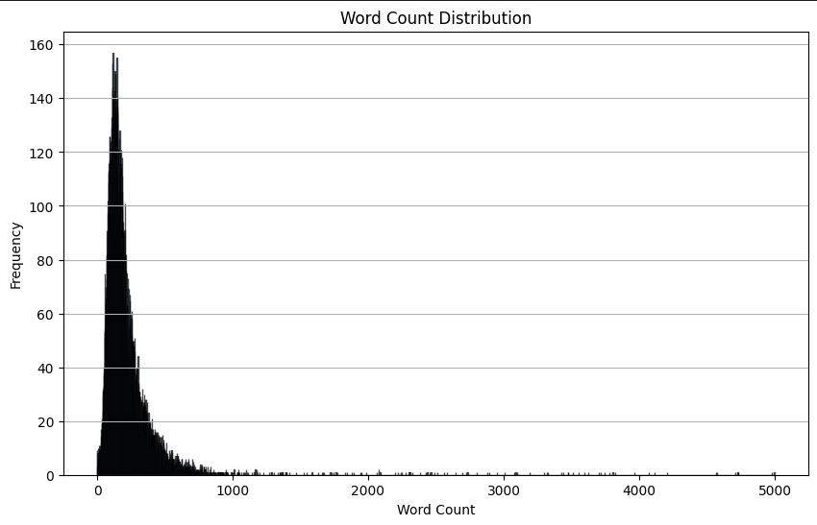
EDA
Preprocessing Steps
EDA

Slide 13
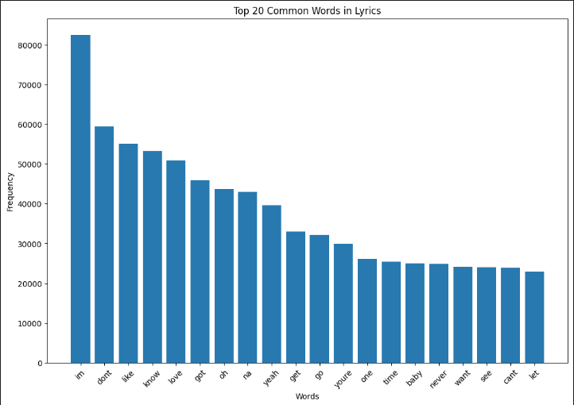
EDA
Preprocessing Steps
EDA

Slide 14
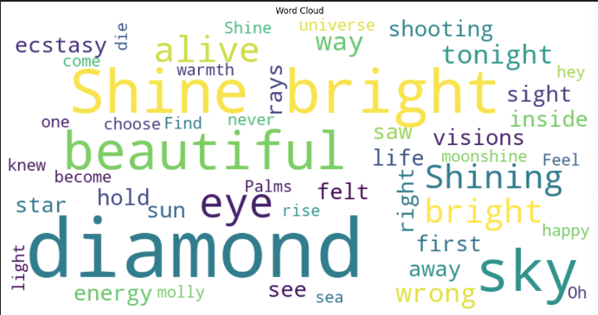
EDA
Preprocessing Steps
EDA

Slide 15
Models
Model & Evaluation
Genre:
cleaned genre (2453 genres)
stemmed genre (2453 genres)
tokenized genre (1417 genres)

Slide 16
Model Evaluation
Feature Engineering
Genres:
✓ One Hot Encoding
✓ Bag-of-Words
✓ TF-IDF
X N-Grams
X Distributed Representations
X Hand-Crafted Features

Slide 17
Feature Engineering
Feature Engineering
Lyrics:
X One Hot Encoding
X Bag-of-Words
✓ TF-IDF
✓ Distributed Representations:
Word2Vec, GloVe, fastText
Doc2Vec
SBERT
X Hand-Crafted Features

Slide 18
Conclusions and Future Work

Slide 19

Thank You

